Slide 1

Fault-Tolerant Quantum Circuit Analysis
Vanderbilt Quantum Initiative
Rae Kapitonova, Zach Macaskill-Smith, Unmol Sharma, Sophie Thompson, and Melissa Warner

Slide 2



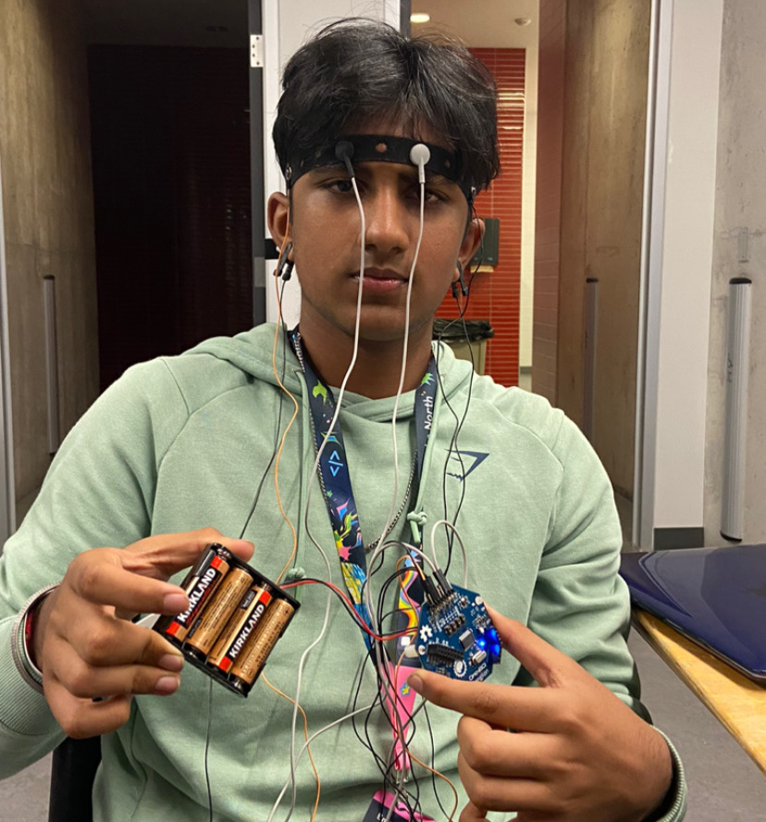
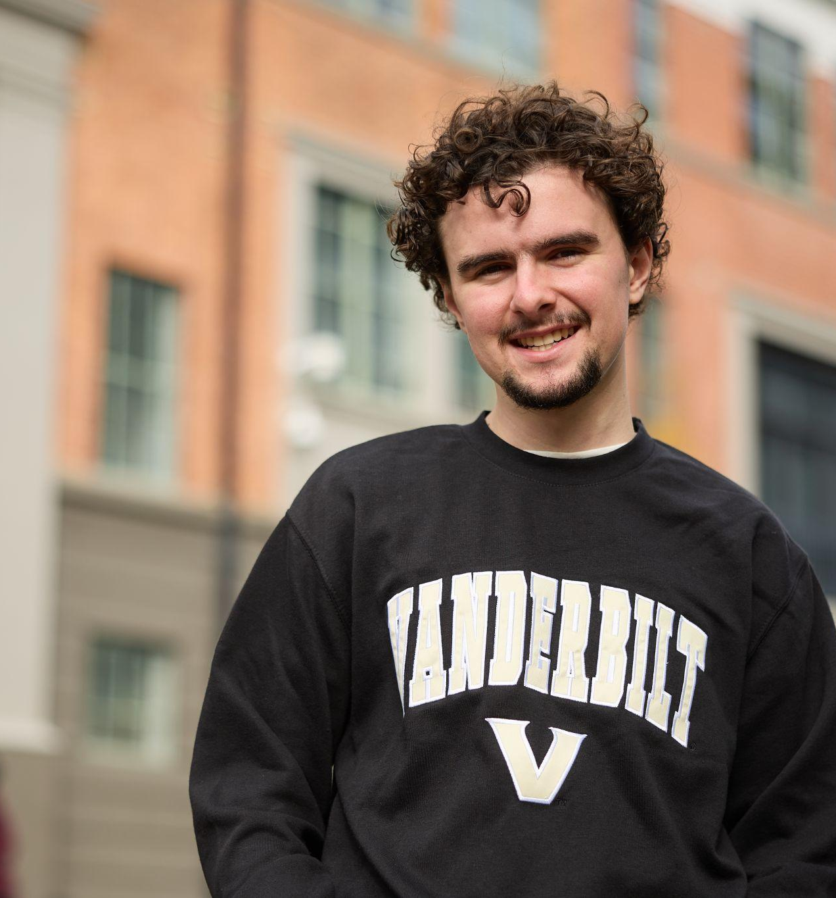
Vanderbilt Quantum Initiative (VQI)
Melissa Warner
Sophie Thompson
Rae Kapitonova
Unmol Sharma
Electrical, Computer + Biomedical Engineering
Freshman
Biomedical, Electrical + Computer Engineering
Freshman
Mechanical Engineering
Freshman
Electrical, Computer + Biomedical
Engineering
Freshman
Zach Macaskill-Smith
Computer Science + Math
Freshman

Slide 3
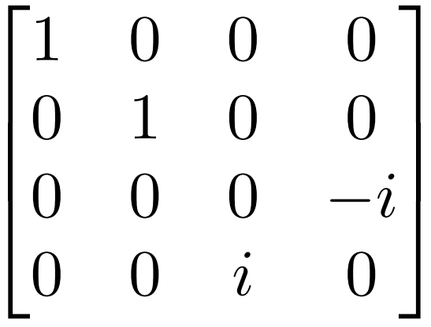
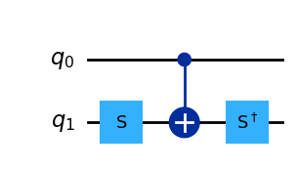
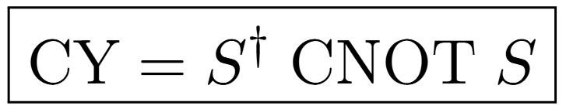
Challenge #1:
Controlled Y-Gate Decomposition
Vanderbilt Quantum Initiative

Slide 4
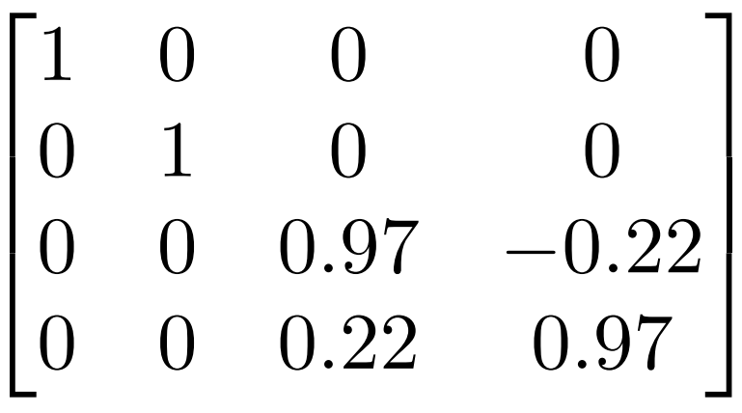
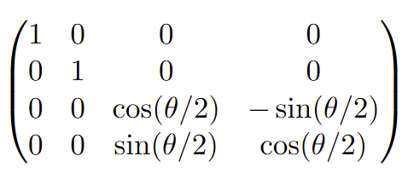
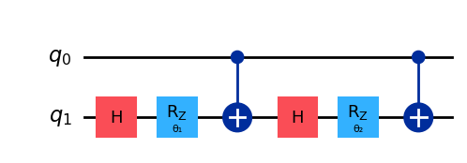
Challenge #2:
Controlled-Ry(π/7) Synthesis
Vanderbilt Quantum Initiative
X
HZH = X
S X S† = Y
R_{y}(θ) = SHR_{z}(θ)HS†

Slide 5
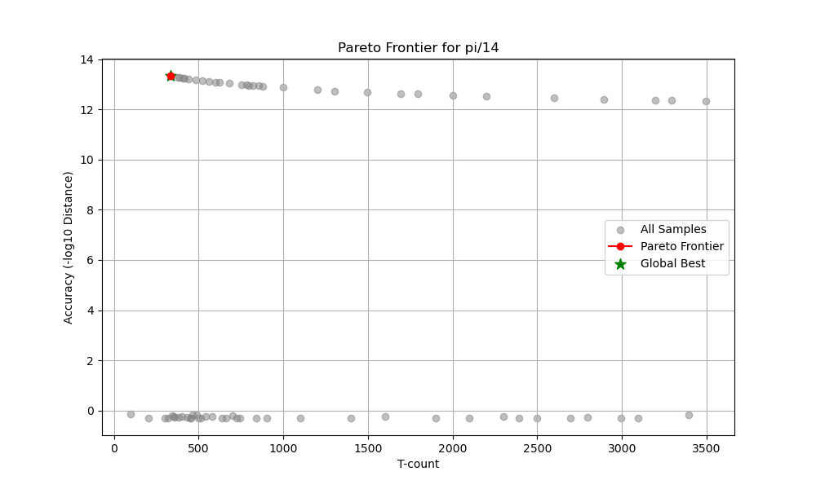
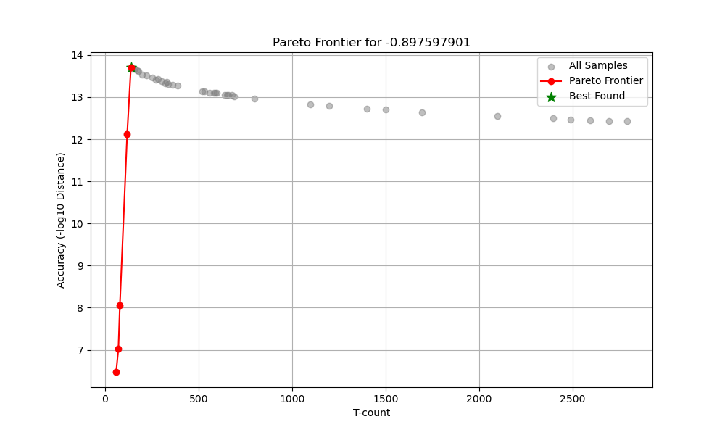
Gridsynth:
Optimizing precision for good results
Vanderbilt Quantum Initiative
Early challenges with Gridsynth sometimes providing weak solutions.
Python automatic workflow identified weak optimizations from gridsynth
Binary Search for drop off
Adaptive search algorithm: explore near good solutions

Slide 6
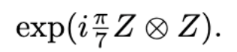
Challenge #3:
Exponential of pauli string
Vanderbilt Quantum Initiative
Gridsynth solves for Rz(theta)
With the optimized combination for the RZ(-2pi/7), this provided a very strong answer.
CNOT — R_{Z}(-2pi/7) – CNOT

Slide 7
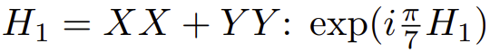
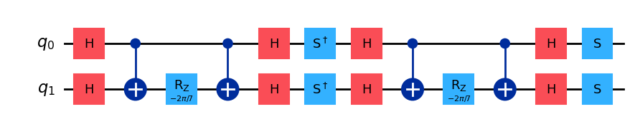
Challenge #4:
Controlled Y-Gate Decomposition
Vanderbilt Quantum Initiative

Slide 8
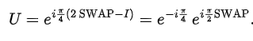
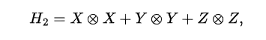
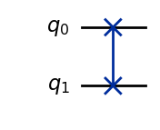
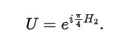
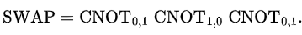
Challenge #5:
Hamiltonian H2
Vanderbilt Quantum Initiative

Slide 9
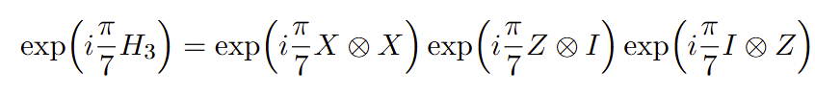
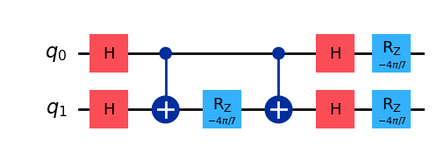
Challenge #6:
Controlled Y-Gate Decomposition
Vanderbilt Quantum Initiative

Slide 10
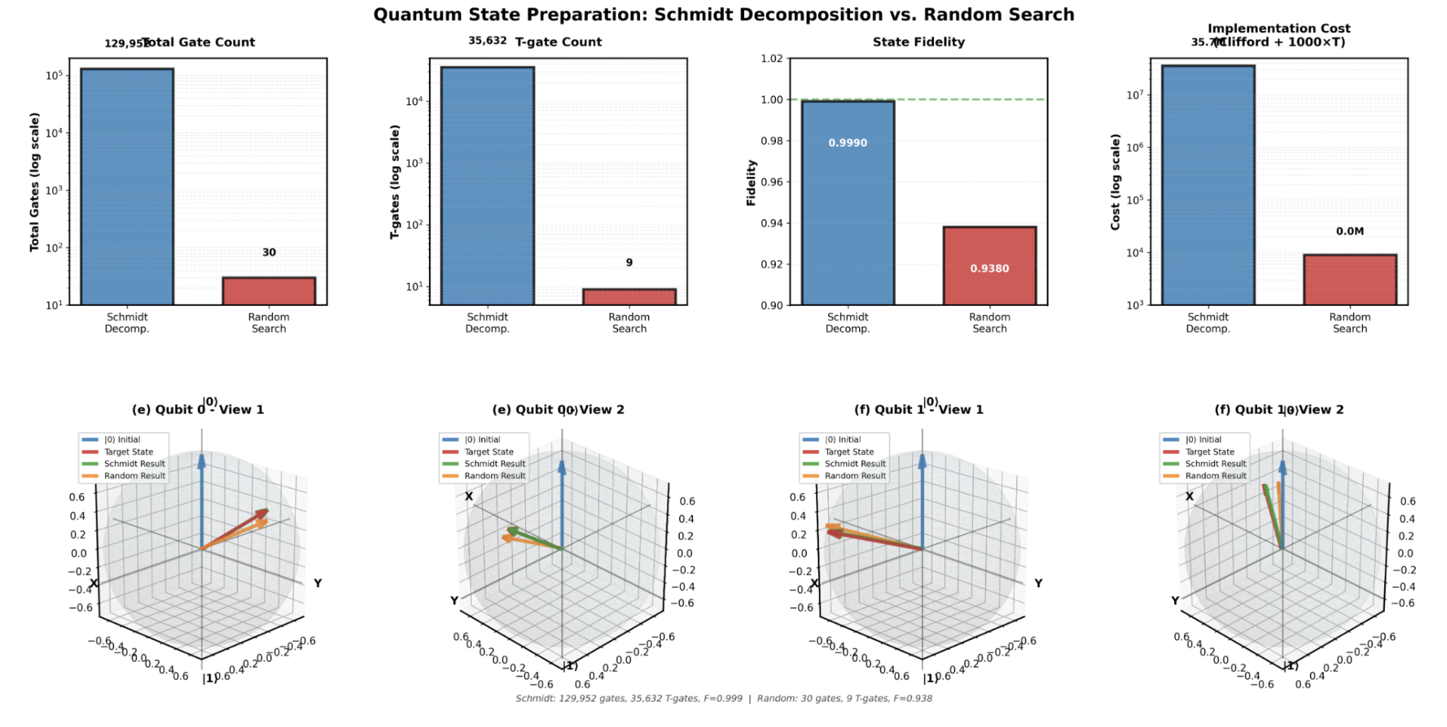
Challenge #7:
State Preparation
Schmidt Decomposition
Monte-Carlo Approach
Vanderbilt Quantum Initiative

Slide 11
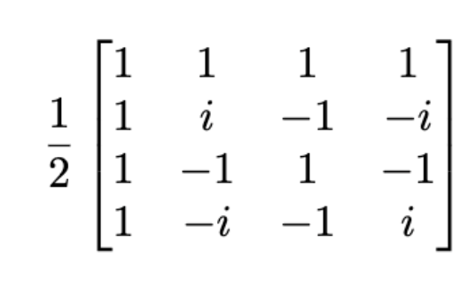
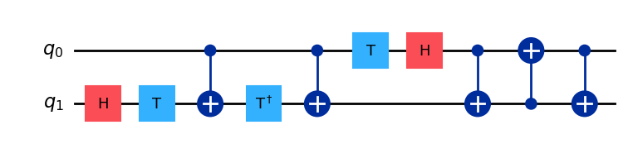
Challenge #8:
Vanderbilt Quantum Initiative
F4 Fourier Transform
T
T Gates: 3
Norm Distance: 3.331e-16

Slide 12
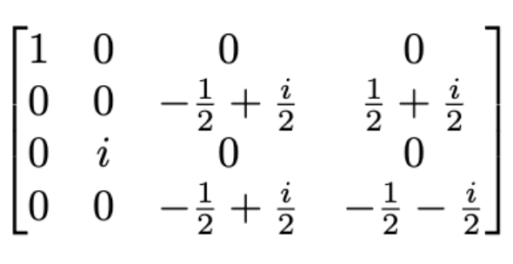
Challenge #9:
Vanderbilt Quantum Initiative
Approaches:
Structure-based Reasoning
Appendations to unitary 8
Synthesis as a search problem

Slide 13
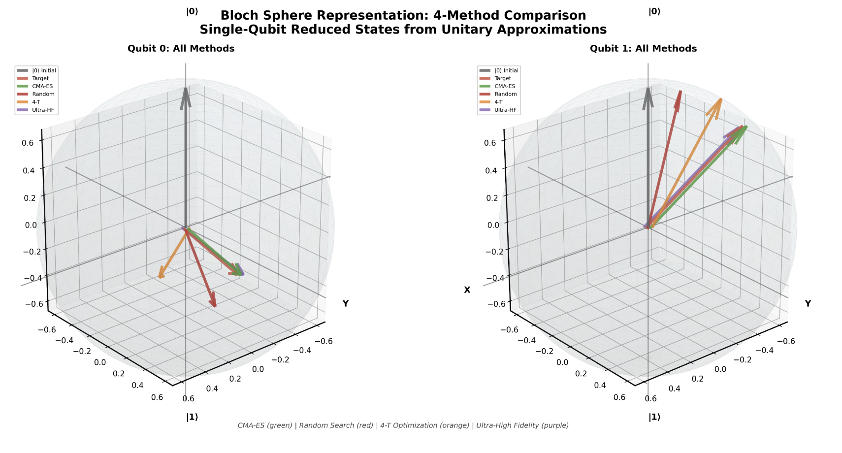
Challenge #10:
Vanderbilt Quantum Initiative
Approaches:
Random Search
CMA-ES Optimization
Min-TCount Optimization
High fidelity synthesis

Slide 14
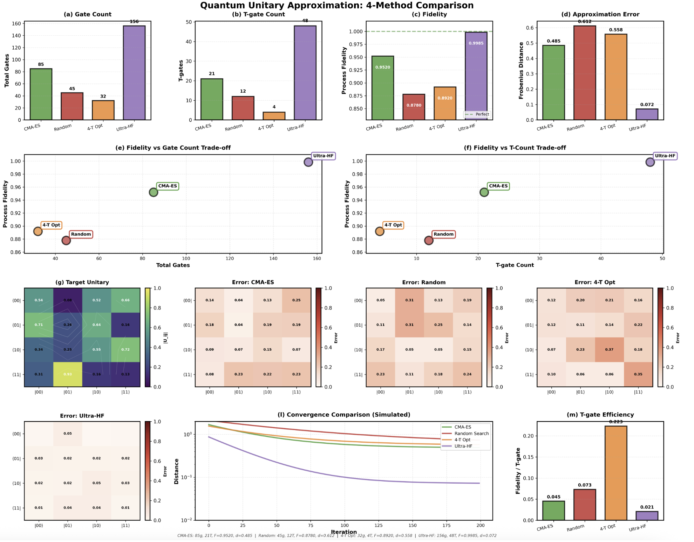
Challenge #10
Vanderbilt
Quantum
Initiative

Slide 15
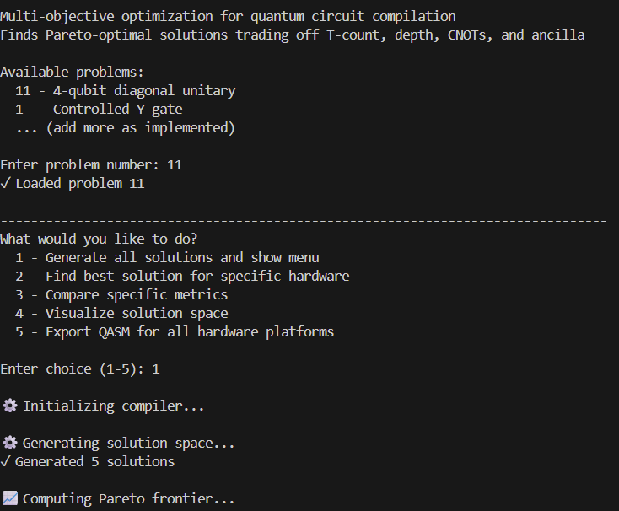
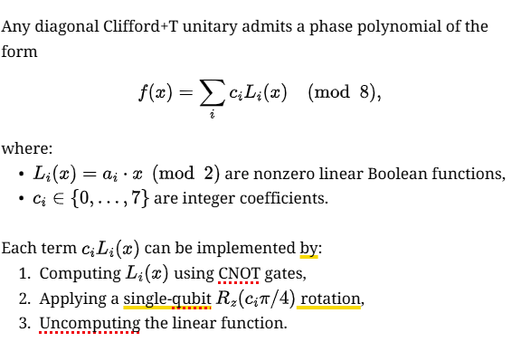
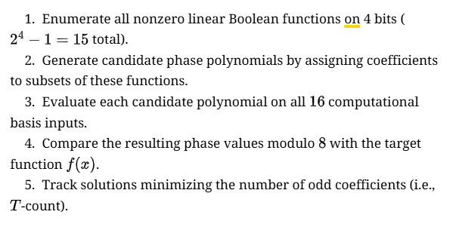
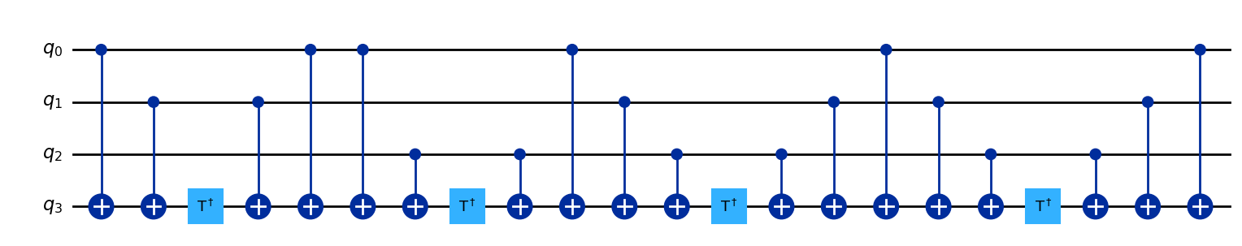
Challenge #11:Phase-Polynomial Synthesis
Vanderbilt Quantum Initiative

Slide 16
Thank you

